Slide 1
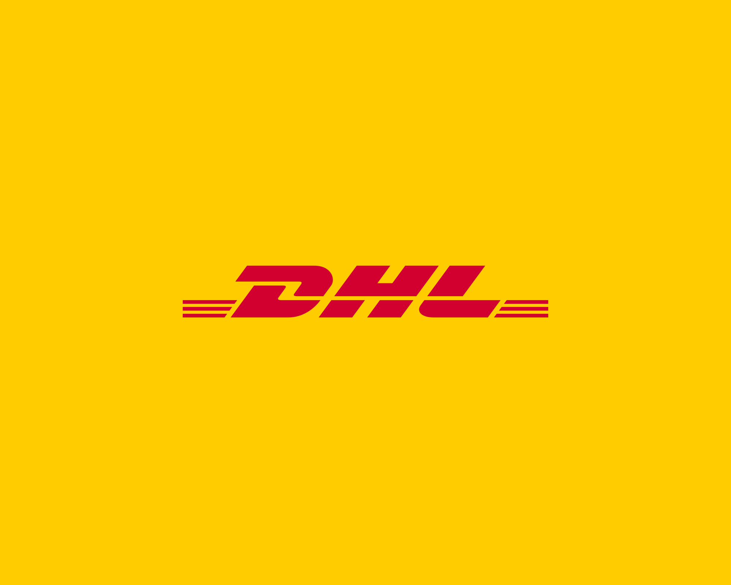

Slide 2
Visitor Statistics and Testimonials
2019 edition attendees – 3,189
2022 edition attendees – 3,572
Year on year increase – 12%
‘I’m one of the Forty Under 40 this year, I own a shipping supply company in the Northeast of the UK, so I’ve come to look for collaborations and see how the industry is doing. It’s been a very enjoyable event.’ Andy Eyre, Managing Director, Norast Supply
‘AntwerpXL has given us great quality and quantity of prospective clients. It is better than Breakbulk Europe as far as I’m concerned, and we’ll definitely be back again next year!’ Robert Vermetten, Director, TPL
‘AntwerpXL has provided us with a much better quality of exhibitors in comparison to other events such as Breakbulk Europe and has allowed us to network on a much more personal level.’ Aadil Sulaiman Hoosen, Regional Director, C. Steinweg Logistics
International visitors in 2022 (compared with 2019)
Belgium 38% (same as 2019)
Netherlands 14% (same as 2019)
Germany 9% (up 4% from 2019)
France 8% (up 3% from 2019)
United Kingdom 7% (up 3% from 2019)
Turkey 6% (up 1% from 2019)
Spain 6% (up 1% from 2019)
Italy 4% (up 1% from 2019)
Poland 3% (up 1% from 2019)
Norway 3% (up 1% from 2019)
AntwerpXL provided an extremely insightful Conference. All sessions were engaging and provided an opportunity for learning and discussion about the future of breakbulk. I have loved being at AntwerpXL and will be coming back next year as it is such a great event for the industry.’ Nataliya Maiseyenka, Transportation Manager, Caterpillar

Slide 3
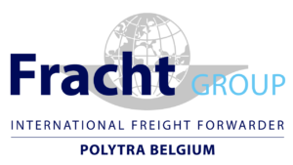
INTERNATIONAL VISITORS
Polytra/Fracht offers tailormade logistics solutions for every logistical need anytime, everywhere.
VARAMAR was created in 2009 to offer semi-liner and tramp services for the transportation of break-bulk, dry-bulk, heavy and oversized cargo by sea.
Ultrabulk is a leading global dry bulk operator, servicing its customers in their maritime transportation needs in the MPP, Parcel, Handysize, Supramax and Panamax segments.
At ArcelorMittal, our goal is to help build a better world with smarter steels. Steels made using innovative processes which are more efficient, use less energy, and emit significantly less carbon.
With 2021 sales and revenues of $51.0 billion, Caterpillar Inc. is the world’s leading manufacturer of construction and mining equipment, off-highway diesel and natural gas engines, industrial gas turbines and diesel-electric locomotives.
Tata Steel is one of the leading steel manufacturing companies of India.

Slide 4
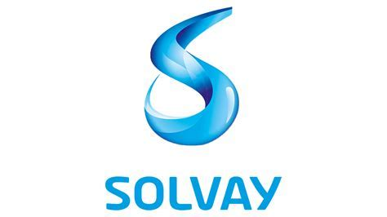
INTERNATIONAL VISITORS
Ballast Nedam is a construction and development company focused on national and international markets.
Denys is a multidisciplinary group specialised in water, energy, mobility, architecture, restoration and special techniques.
Vestas is the energy industry’s global partner on sustainable energy solutions.
Solvay is a science company whose technologies bring benefits to many aspects of daily life.
We bond people, ideas and elements to reinvent progress. We are a science company whose technologies bring benefits to many aspects of daily life.

Slide 5
Why attend AntwerpXL?
MAXIMISE YOUR RMaximize your brand exposure & return on investment
This is a fantastic opportunity to network with new and existing customers, generate valuable leads and drive your business forward. By booking today you will benefit from exposure throughout the full marketing campaign over the next 12 months.
Targeted event focused on the breakbulk community
85% of the 2022 floorplan has re-booked their space for 2023
Hosted by the Port of Antwerp, in the home of breakbulk
Countless networking opportunities including late night networking, our one-to-one meeting programme, Antwerp port tour and much more
International strategy in place to grow the event for 2023 into Hall 4+5, in partnership with the Port of Antwerp. This will include working with international agents, media partners and associations to drive international exhibitors and visitors over a 12-month marketing campaign. Partners we are working with in 2023 include the International Federation of Freight Forwarders Associations, Atlas Breakbulk Alliance, Overseas Project Cargo Association, Global Trade Magazine and many more.
AntwerpXL 2023 will bring you a larger hall with personalised networking experiences, via an exclusive VIP programme and tailored 1-2-1 meeting opportunities.

Slide 6
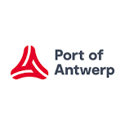
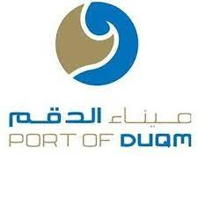
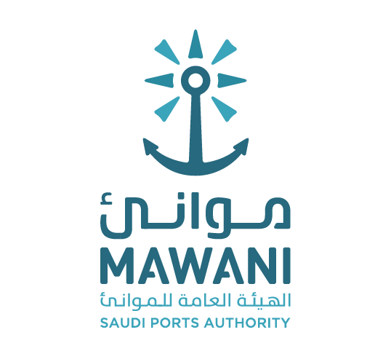
Current exhibitors / sponsors Be seen alongside some of the best suppliers in the breakbulk and project cargo industry including:
2022 sponsors

Slide 7
2023 Sponsorship Options
Having looked at the remaining sponsorship options available for DHL we would suggest going for the speaking and potentially the bag sponsorship option to maximise your brand exposure and lead generation.
Speaking slot includes:
Naming rights to session
30 minute speaking slot (work with conference team on the theme of the session )
Spotlight in the Show preview sent to over 40 media partners
Enhanced profile in the AXL newsletter
2 x social media post
Horizontal banner on AXL website
E-shot to global database
Data of the delegates that attend your conference session (opt-ins)
Bespoke invite created inviting target audience to session
Free guest passes for invited guest to conference
€6,000
Bar Sponsorship:
A unique opportunity to provide your logo and branding in the networking bar, alongside the opportunity to distribute sales and marketing material or even have a signature drink.
A great way to showcase your brand to senior decision-makers, and have a space to bring your best clients
€20,000

